Slide 1

Trying to understand suicide better
By Michael Miller

Slide 2
Coal Gas in the United Kingdom
Prior to the 1950s, domestic gas in the United Kingdom was derived from coal and contained about 10-20% carbon monoxide
Poisoning by gas inhalation was the leading means of suicide in the UK
In 1958 natural gas (virtually free of carbon monoxide) was introduced into the UK
Suicides by carbon monoxide decreased dramatically, obviously.
But what about over all suicides in UK? Did People who want to kill themselves just commit suicide a different way?

Slide 3
Coal Gas in the United Kingdom (continued)
NO!!!!!
Suicides by other methods increased only a small amount, resulting in a net decrease in overall suicides
when they looked at suicide rate by gender, they also notice that female suicide rates went down dramatically more then male suicide rates
an estimated six to seven thousand lives were saved by the change in domestic gas content (Hawton 2002)

Slide 4
Golden Gate Bridge a "suicide magnet",
second-most used suicide site/bridge in the world
an estimated 1,700 people have killed themselves by jumping off the bridge since its construction.
In the late 90s the bridge was fitted with suicide-hotline telephones and staff patrol the bridge in carts looking for people who appear to be planning to jump Which reduced the number of jumpers and San Francisco overall suicide numbers
Still In 2016, 39 people died jumping off the bridge. Another 184 came to the bridge intending to harm themselves but were stopped
Until recently attempts to introduce a suicide barrier have been thwarted by engineering difficulties, high costs, and public opposition. But was finally approved in 2018 and is estimated to be complete in 2023.

Slide 5
Numerous studies have shown People who want to commit suicide want to do it a certain way. If they can’t kill themselves the way they wanted, most give up on suicide altogether

Slide 6
My Research
There are already well-known differences between male and female suicides, and some suicide prevention is tailored specifically to a certain gender
I wanted to see if different races in America had different methods of preferred suicided
If one race is more apt to kill themselves a certain way suicide prevention methods should be tailored to different on races
I went through CDC records of death from 1999-2018 to collect my data

Slide 7
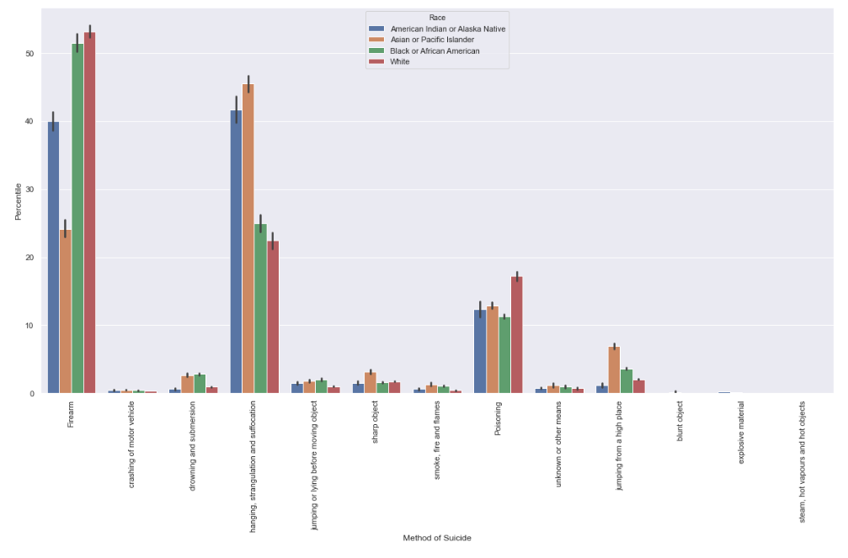

Slide 8
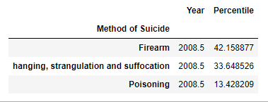
Overall The three biggest methods of suicide by percentile are
Suicide by Firearms
Suicide by Hanging, Strangulation and Suffocation
Suicide by Poisoning

Slide 9
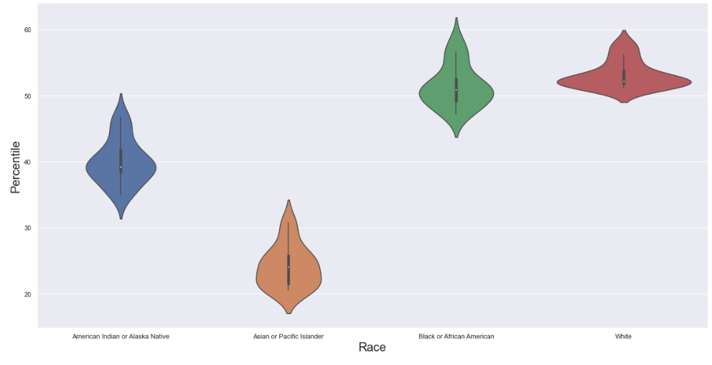
Firearms

Slide 10

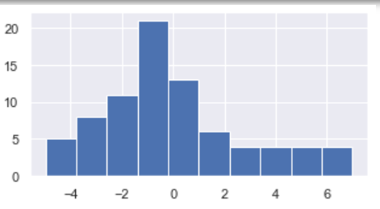
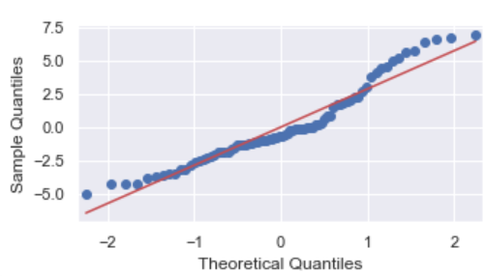

Visualize the residuals to inspect normality

Slide 11
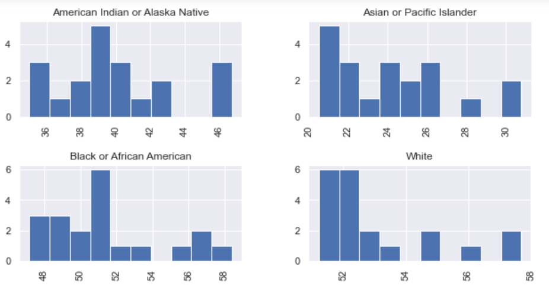
Can we do a Kruskal Wallis Test? Do all groups should have the same shape distributions?

Slide 12



Mann Whitney u test
If alpha =.05
If alpha = (.05)^6

Slide 13
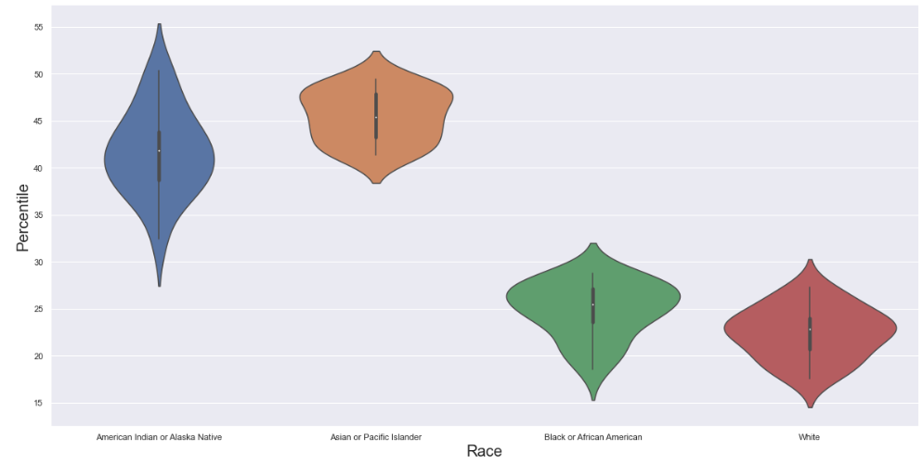
Hanging, strangulation and suffocation

Slide 14
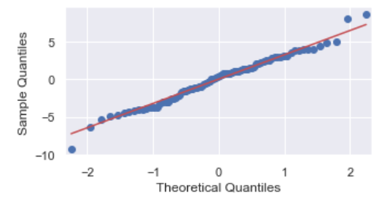
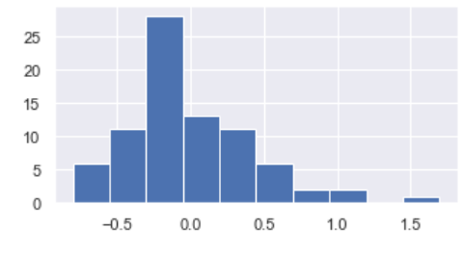

Visualize the residuals to inspect normality

Slide 15


No significant difference between white and black ethnicities
Asians and Natives are way more likely to hang themselves compared to whites and blacks
Asians are even more significantly statistic to hang themselves compared to Natives

Slide 16
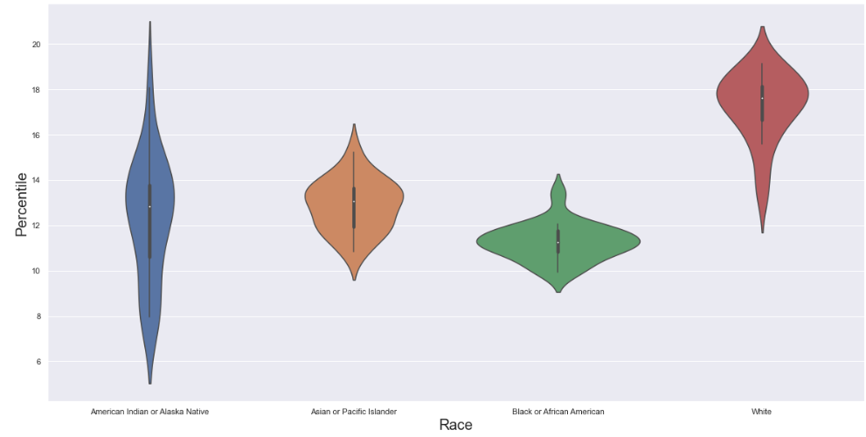
Poisoning

Slide 17

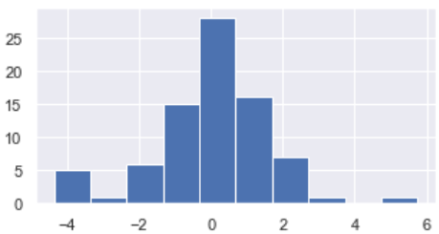
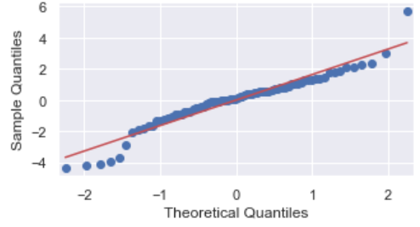

Visualize the residuals to inspect normality
This Photo by Unknown Author is licensed under CC BY-SA-NC

Slide 18

Can we do a Kruskal Wallis Test? Do all groups should have the same shape distributions?

Slide 19


Mann Whitney u test
If alpha =.05
If alpha =(.05)^6

Slide 20
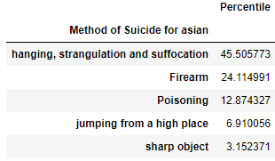
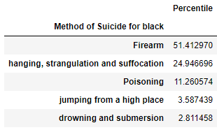

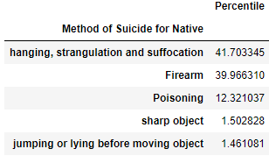
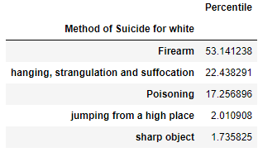

So we’ve noticed different trends between the three-leading methods of suicide but let's take a closer look at the five-leading methods of each of the four race groups
This Photo by Unknown Author is licensed under CC BY-NC-ND
This Photo by Unknown Author is licensed under CC BY-ND

Slide 21
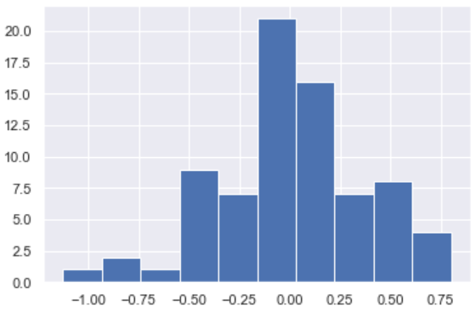


Visualize the residuals to inspect normality of suicide for drowning

Slide 22
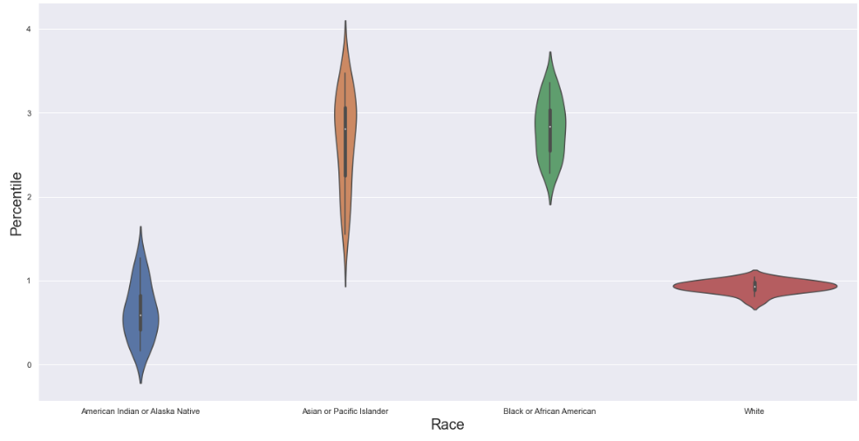

Drowning and Submersion

Slide 23
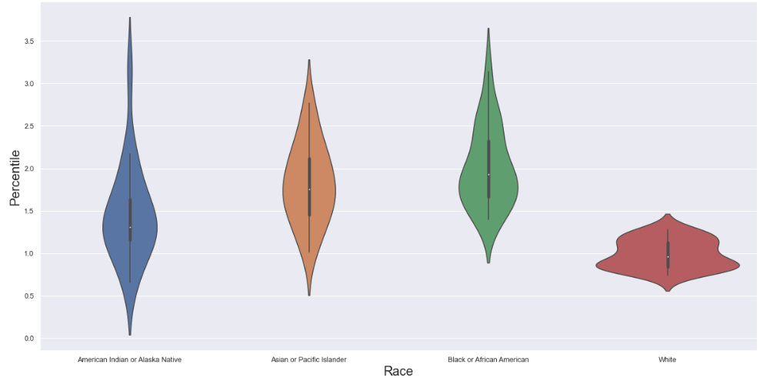
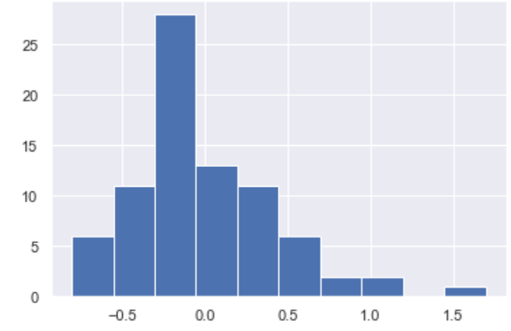


Visualize the residuals to inspect normality of suicide for jumping or lying before a moving object

Slide 24
Conclusions
Some methods of suicide such as hanging and drowning, we are 95% sure there is a statistical difference between the races in America
Other methods of suicide like firearms and poisoning had unusall data sets which made statically measuring difficult. While we can’t say with 95% confidence there is a significant difference, we can tell from the violin plots there is sum difference
In conclusion I would recommend some tailoring to suicide prevention methods to the different races

